Slide 1

RECYCLED CONCRETE AGGREGATE
National Institute Of Technology Hamirpur
Himachal Pradesh- 177005
End Semester Presentation (CE-419)
PROJECT CONTRIBUTORS :-
VISHAL KUMAR (20BCE056)
HEMANT SINGH (20BCE063)
RISHI DHIMAN (20BCE090)
SUMIT DHIMAN (20BCE091)
DEEKSHA KUMARI (20BCE092)
MEHUL KUMAR MEENA (20BCE116)
TANZIN PALJOR (20BCE118)
PROJECT SUPERVISOR:-
Dr. VIMAL KUMAR

Slide 2
Table Of Content
Introduction
Project Objective
Methodology Adopted
Tests Conducted
Fineness Modulus
Flakiness Index
Elongation index
Impact Value
Crushing Value
Abrasion Value
Specific Gravity
Water absorption
Conclusion from the testing of aggregate
Casting of concrete cubes
Compression testing of concrete cubes
Conclusion
References

Slide 3

Recycled Concrete Aggregate (RCA) is a sustainable construction material that can be used as a replacement for conventional aggregates in concrete production to some extent. This project presentation report outlines the objectives, methodology, and key findings of a various tests conducted on RCA and come to a conclusion that how much percentage of natural aggregate can be replace with RCA with negligible effect on strength of the concrete.

Slide 4

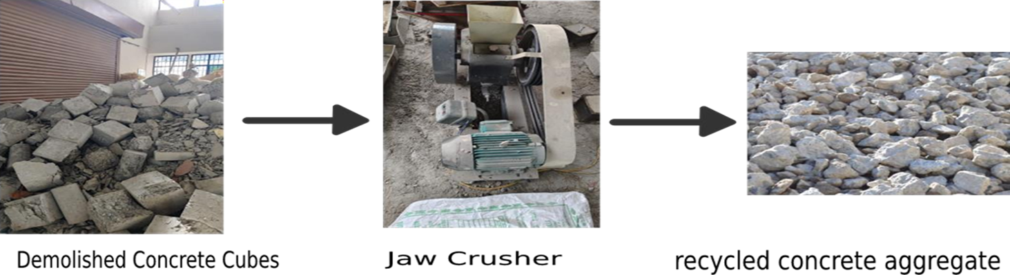
PROJECT OBJECTIVE
The primary objective of this project is to investigate the feasibility and advantages of using recycled aggregates in concrete production, with a focus on sustainability, performance, and cost-effectiveness.

Slide 5
METHODOLOGY ADOPTED
After testing the different properties of materials used in preparation of concrete from both types of aggregates we have adopt a methodology.
We have changed the percentage composition of the total aggregate with recycled concrete aggregate and natural aggregate. As the cost of recycled concrete aggregate is much lesser then that of natural aggregate we have find the maximum percentage of recycled concrete aggregate which can be used in total aggregate without affecting the strength of the concrete.
Total coarse aggregate used | %age of natural aggregate used | %age of recycled concrete aggregate used
100% | 100% | 0%
100% | 85% | 15%
100% | 70% | 30%
100% | 0% | 100%

Slide 6
1. FINENESS MODULUS
FOR RECYCLED CONCRETE AGGREGATE
Sr. no. | SIEVE SIZE (mm) | RETAINED (kg) | %age RETAINED | Cum. %age RETAINED | Cum. %age PASSING
1 | 80 | 0 | 0 | 0 | 100
2 | 40 | 0 | 0 | 0 | 100
3 | 20 | 0.396 | 9.954 | 9.954 | 90.046
4 | 10 | 1.690 | 42.48 | 52.434 | 47.566
5 | 4.75 | 1.008 | 25.33 | 77.764 | 22.236
6 | 2.36 | 0.884 | 22.38 | 100 | 0
7 | 1.18 | 0 | 0 | 100 | 0
8 | 0.6 | 0 | 0 | 100 | 0
9 | 0.3 | 0 | 0 | 100 | 0
10 | 0.15 | 0 | 0 | 100 | 0
TOTAL |  |  |  | 640.152
F.M. = Σcum. %age Retained = 640.152/100 = 6.40
100

Slide 7
1. FINENESS MODULUS
FOR NATURAL AGGREGATE
Sr. no. | SIEVE SIZE (mm) | RETAINED (kg) | %age RETAINED | Cum. %age RETAINED | Cum. %age PASSING
1 | 80 | 0 | 0 | 0 | 100
2 | 40 | 0 | 0 | 0 | 100
3 | 20 | 0.385 | 7.7 | 7.7 | 92.3
4 | 10 | 3.195 | 78.3 | 86 | 14
5 | 4.75 | 0.700 | 14 | 100 | 0
6 | 2.36 | 0 | 0 | 100 | 0
7 | 1.18 | 0 | 0 | 100 | 0
8 | 0.6 | 0 | 0 | 100 | 0
9 | 0.3 | 0 | 0 | 100 | 0
10 | 0.15 | 0 | 0 | 100 | 0
TOTAL |  |  |  | 693.7
F.M. = Σcum. %age Retained = 693.7/100 = 6.94
100

Slide 8
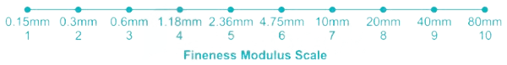
FOR RECYCLED CONCRETE AGGREGATE
FOR NATURAL AGGREGATE
F.M. = Σcum. %age Retained/100
= 640.152/100
= 6.40
F.M. = Σcum. %age Retained/100
= 693.7/100
= 6.94
Average size of both aggregates lies between (4.75-20)mm
Maximum size of both aggregates is 40mm
Nominal maximum size of both aggregates is 20mm

Slide 9
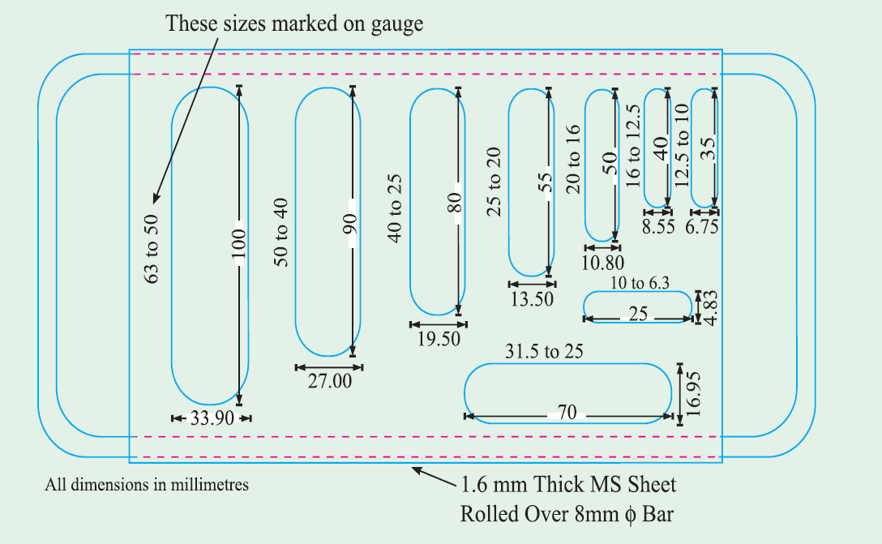
2. FLAKINESS INDEX
THICKNESS GAUGE

Slide 10
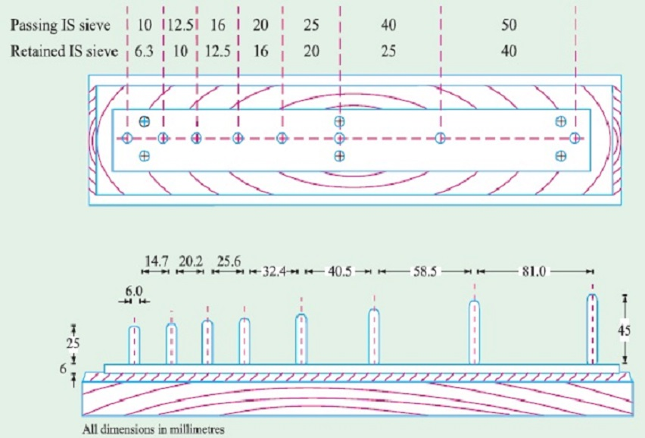
2. ELONGATION INDEX
LENGTH GAUGE

Slide 11
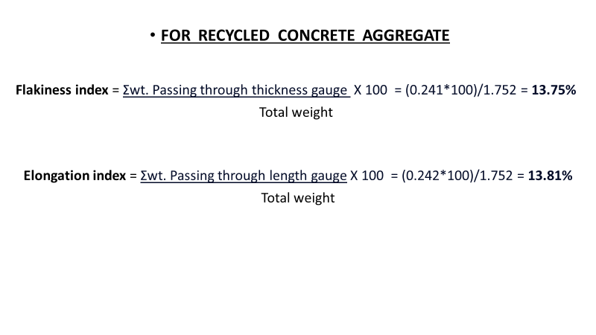
2. FLAKINESS and ELONGATION INDEX
FOR RECYCLED CONCRETE AGGREGATE
Sr. no. | Passing Sieve Size(mm) | Retained Sieve Size(mm) | Total Weight (kg) | Weight Passing Through Thickness Gauge(kg) | Weight Retained On Thickness Gauge(kg) | Weight Retained On Elongation Gauge(kg
1 | 63 | 50 | 0 | 0 | 0 | 0
2 | 50 | 40 | 0 | 0 | 0 | 0
3 | 40 | 25 | 0.273 | 0.048 | 0.225 | 0
4 | 25 | 20 | 0.589 | 0.027 | 0.562 | 0.153
5 | 20 | 16 | 0.373 | 0.072 | 0.301 | 0.044
6 | 16 | 12.5 | 0.075 | 0.007 | 0.066 | 0.004
7 | 12.5 | 10 | 0.285 | 0.040 | 0.245 | 0.023
8 | 10 | 6.3 | 0.159 | 0.047 | 0.112 | 0.018
TOTAL |  |  | 1.752 | 0.241 | 1.511 | 0.242

Slide 12
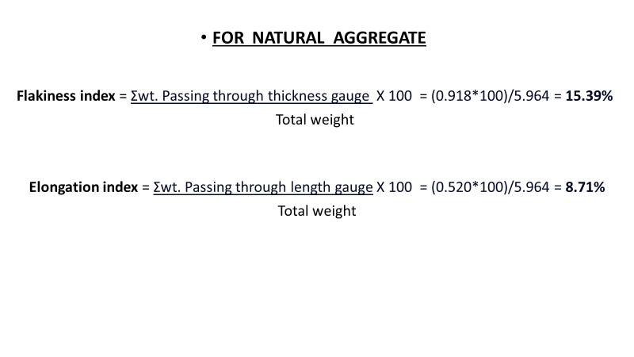
2. FLAKINESS and ELONGATION INDEX
FOR NATURAL AGGREGATE
Sr. no. | Passing Sieve Size(mm) | Retained Sieve Size(mm) | Total Weight (kg) | Weight Passing Through Thickness Gauge(kg) | Weight Retained On Thickness Gauge(kg) | Weight Retained On Elongation Gauge(kg
1 | 63 | 50 | 0 | 0 | 0 | 0
2 | 50 | 40 | 0 | 0 | 0 | 0
3 | 40 | 25 | 0 | 0. | 0 | 0
4 | 25 | 20 | 3.086 | 0.472 | 2.614 | 0.188
5 | 20 | 16 | 1.876 | 0.216 | 1.660 | 0.160
6 | 16 | 12.5 | 0.594 | 0.110 | 0.484 | 0.080
7 | 12.5 | 10 | 0.310 | 0.088 | 0.222 | 0.076
8 | 10 | 6.3 | 0.098 | 0.032 | 0.066 | 0.016
TOTAL |  |  | 5.964 | 0.918 | 5.046 | 0.520

Slide 13
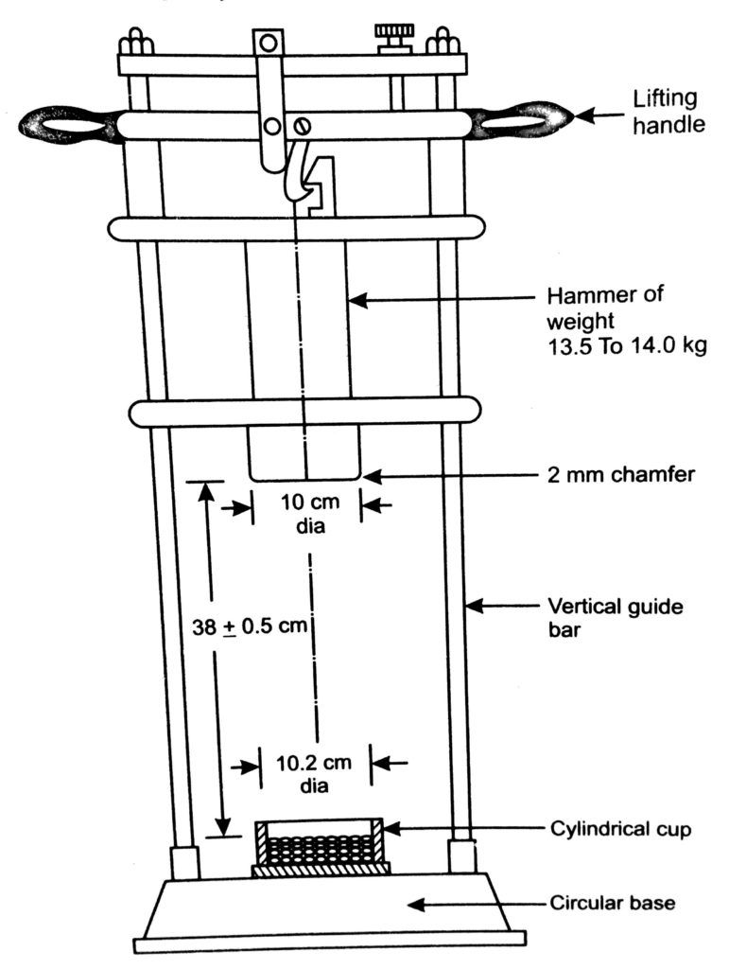
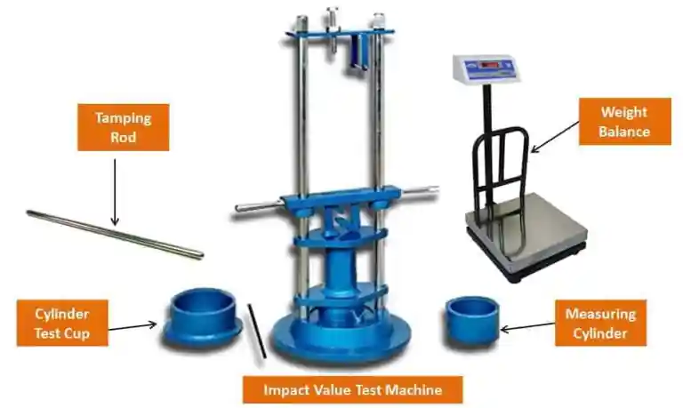
3. AGGREGATE IMPACT VALUE TEST
IMPACT VALUE TEST MACHINE

Slide 14
3. AGGREGATE IMPACT VALUE TEST
FOR RECYCLED CONCRETE AGGREGATE
FOR NATURAL AGGREGATE
Net weight of aggregates in the measure (gm) (A) | The fraction passing through 2.36mm IS sieve (gm) (B) | The fraction retained on 2.36 mm IS sieve (gm) (C) | Aggregate impact value {(B*100)/A} %
548 | 94 | 454 | 17.153%
Net weight of aggregates in the measure (gm) (A) | The fraction passing through 2.36mm IS sieve (gm) (B) | The fraction retained on 2.36 mm IS sieve (gm) (C) | Aggregate impact value {(B*100)/A} %
525 | 89 | 436 | 17.08%

Slide 15
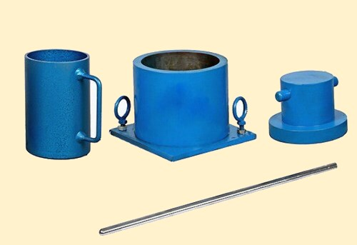
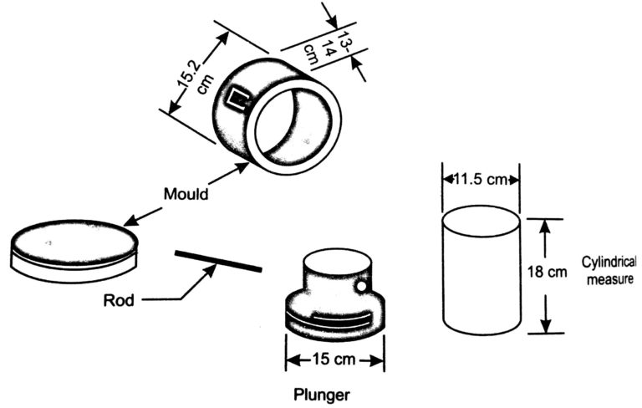
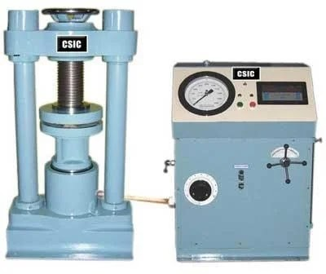
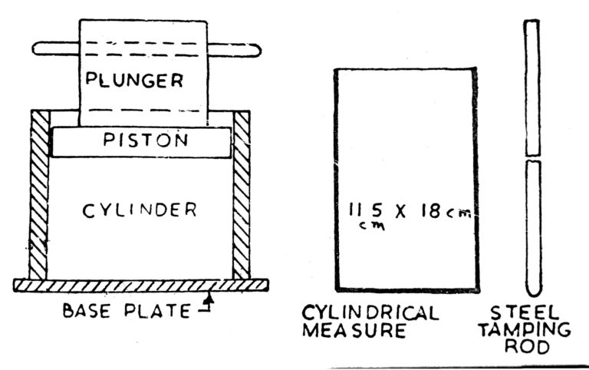
4. AGGREGATE CRUSHING VALUE TEST
COMPRESSION TESTING MACHINE

Slide 16
4. AGGREGATE CRUSHING VALUE TEST
FOR RECYCLED CONCRETE AGGREGATE
FOR NATURAL AGGREGATE
Net weight of aggregates in the measure (gm) (A) | The fraction passing through 2.36mm IS sieve (gm) (B) | The fraction retained on 2.36 mm IS sieve (gm) (C) | Aggregate impact value {(B*100)/A} %
2290 | 448 | 1842 | 19.56%
Net weight of aggregates in the measure (gm) (A) | The fraction passing through 2.36mm IS sieve (gm) (B) | The fraction retained on 2.36 mm IS sieve (gm) (C) | Aggregate impact value {(B*100)/A} %
2118 | 423 | 1694 | 19.97%

Slide 17
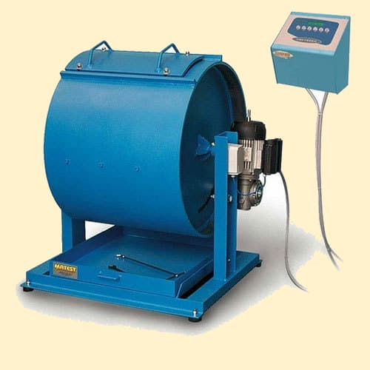
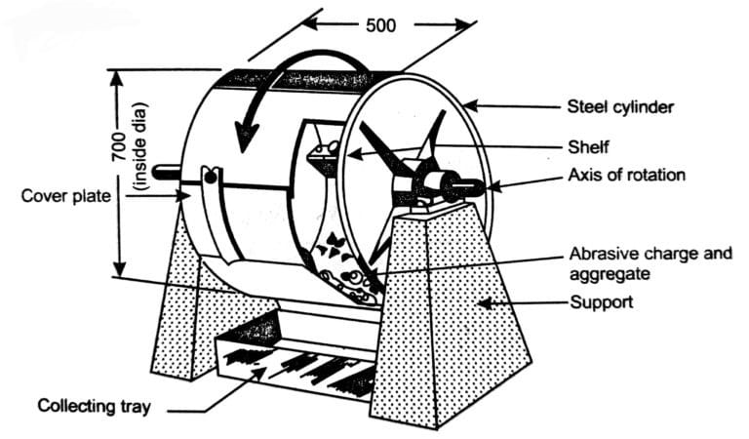
5. LOS ANGELES ABRASION VALUE TEST
LOS ANGELES ABRASION MACHINE

Slide 18
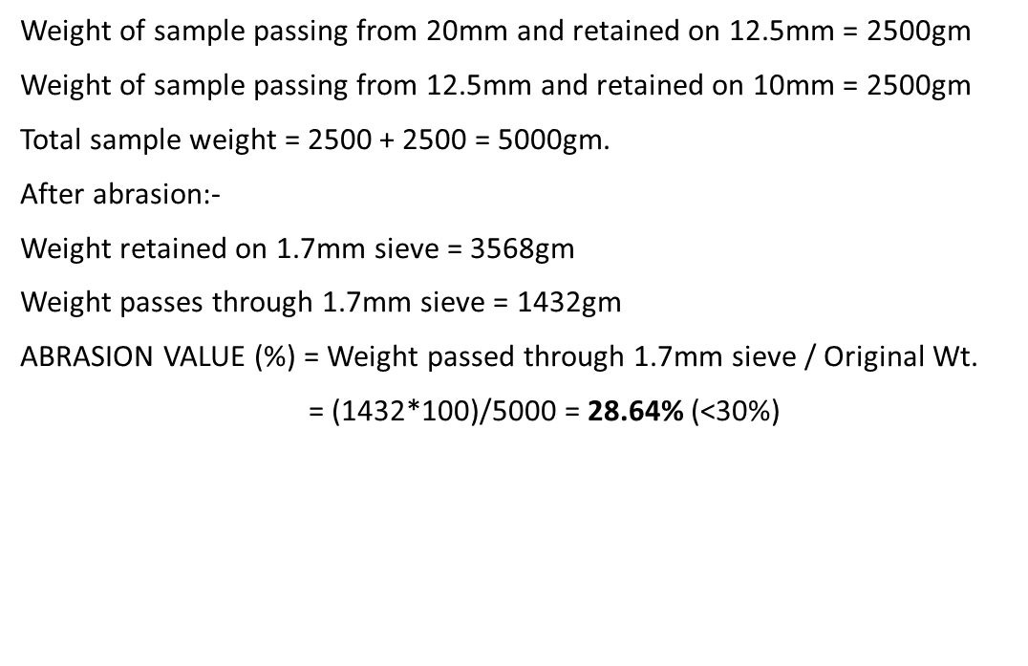
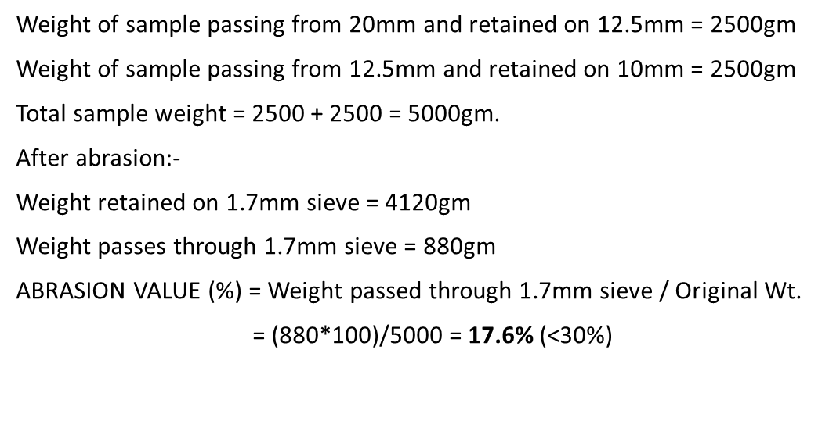
5. LOS ANGELES ABRASION VALUE TEST
FOR RECYCLED CONCRETE AGGREGATE
FOR NATURAL AGGREGATE

Slide 19
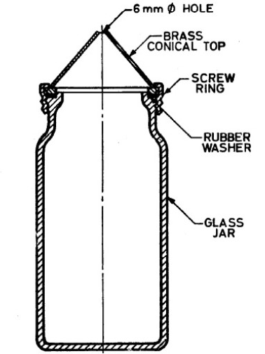
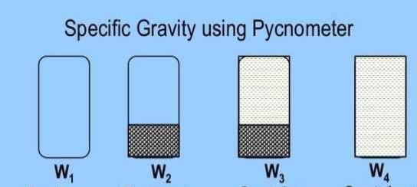
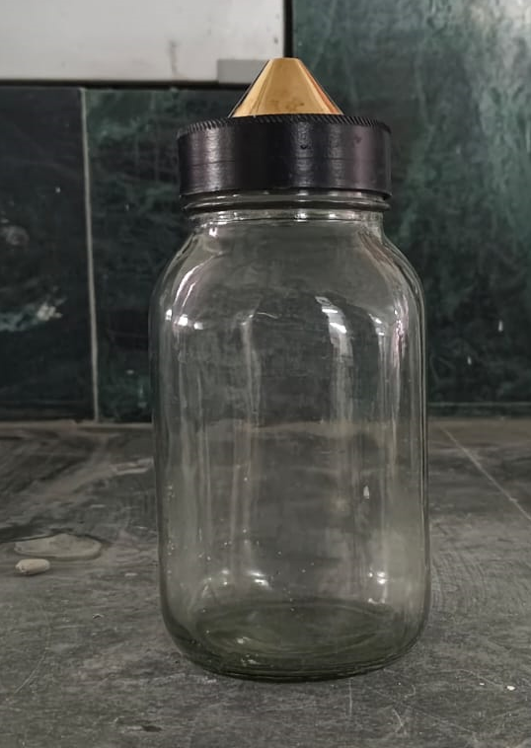
6. SPECIFIC GRAVITY TEST OF AGGREGATE

Slide 20
6. SPECIFIC GRAVITY TEST OF AGGREGATE
FOR RECYCLED CONCRETE AGGREGATE
FOR NATURAL AGGREGATE
Weight of empty jar (W1) = 532 gm
Weight of (jar+ sample) (W2) = 1202 gm
Weight of (jar+ sample +water) (W3) = 1940 gm
Weight of (jar+ water) (W4) = 1520 gm
Specific gravity of aggregate = (W2-W1)/{(W2-W1)-(W3-W4)}
= (1202-532)/{(1202-532)-(1940-1520)}
=(670)-/(670-420) = 670/250 = 2.68
Weight of empty jar (W1) = 532 gm
Weight of (jar+ sample) (W2) = 1384 gm
Weight of (jar+ sample +water) (W3) = 2058 gm
Weight of (jar+ water) (W4) = 1546 gm
Specific gravity of aggregate = (W2-W1)/{(W2-W1)-(W3-W4)}
= (1384-532)/{(1384-532)-(2058-1546)}
=(852)-/(852-512) = 852/340 = 2.505

Slide 21
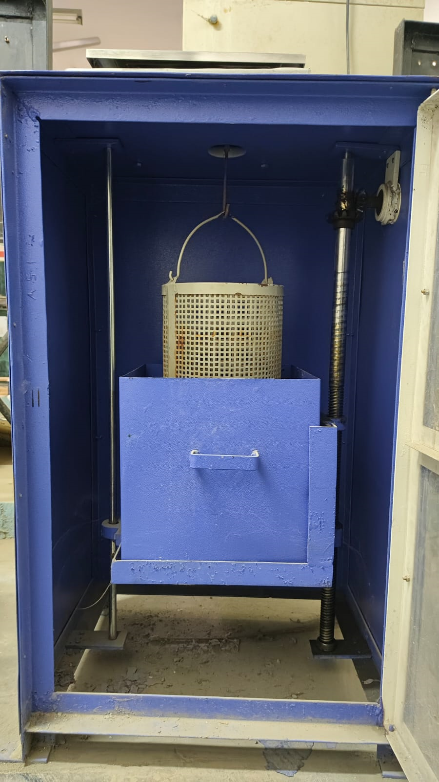
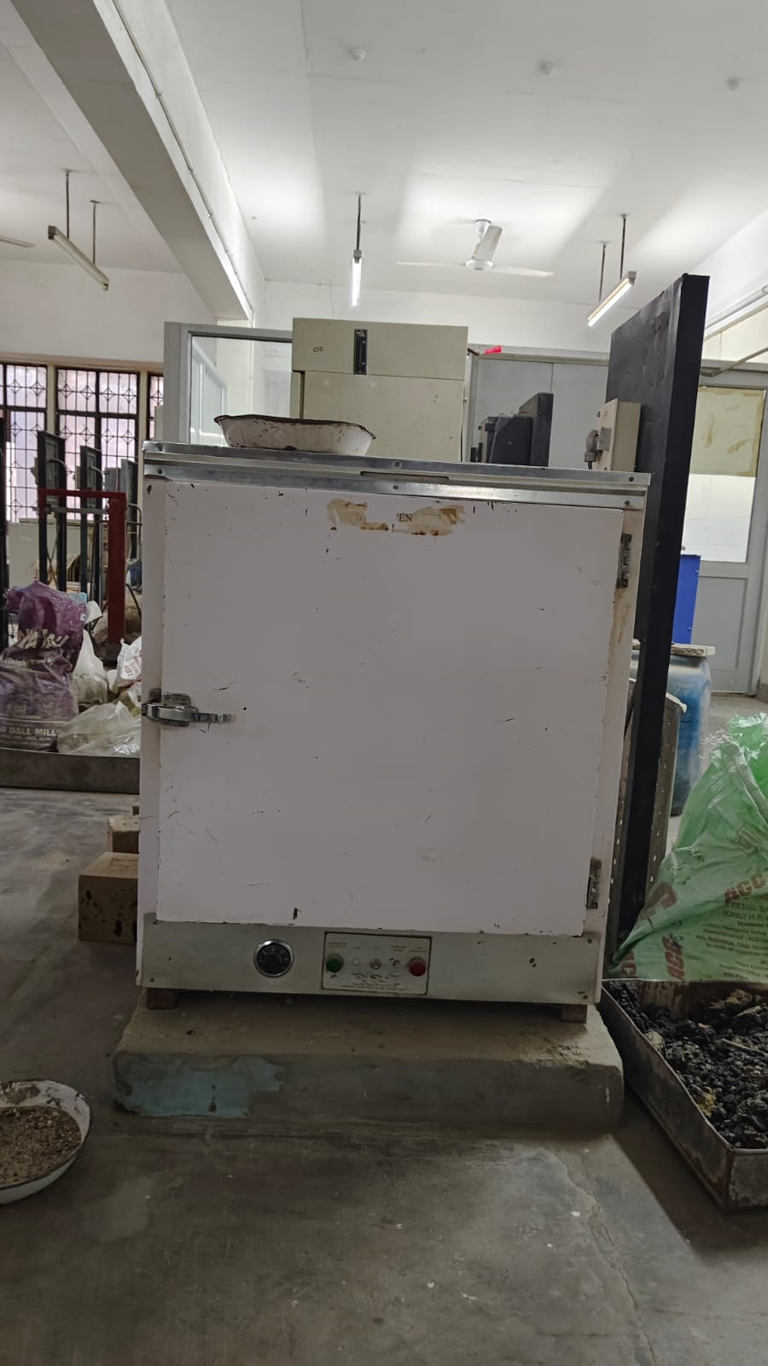
7. WATER ABSORPTION TEST OF AGGREGATE
SETUP OF ABSORPTION TEST
OVEN

Slide 22
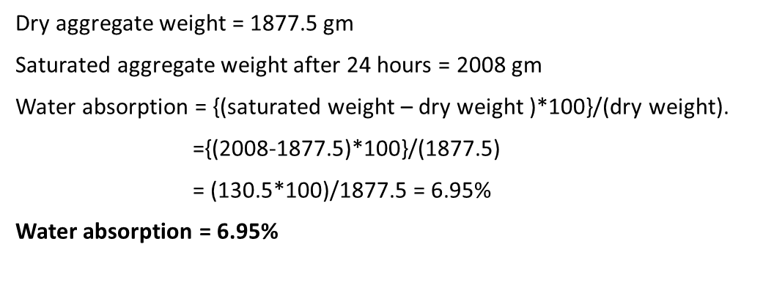
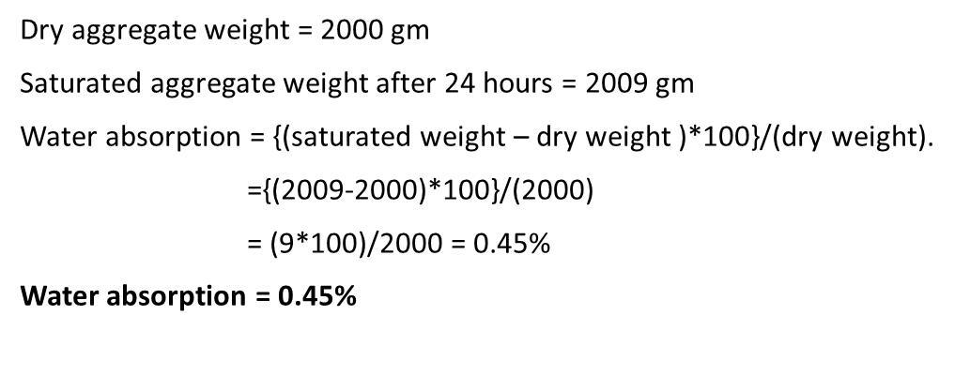
7. WATER ABSORPTION TEST OF AGGREGATE
FOR NATURAL AGGREGATE
FOR RECYCLED CONCRETE AGGREGATE

Slide 23
Comparative Conclusion from the aggregates testing
Sr.no. | TEST PERFORMED | Result for natural aggregate | Result for recycled concrete aggregate
1. | Fineness modulus | 6.94 | 6.40
2. | Flakiness index | 15.39% | 13.75%
 | Elongation index | 8.71% | 13.81%
3. | Impact value | 17.08% | 17.153%
4. | Crushing value | 19.97% | 19.56%
5. | Los angeles abrasion value | 17.6% | 28.64%
6. | Specific gravity | 2.68 | 2.505
7. | Water absorption | 0.45% | 6.95%

Slide 24
Design mix data for M25 grade of concrete
1.Stipulations for proportioning
Grade designation - M25
Type of cement – PPC
Max nominal size of aggregate – 20mm
Workability – 75mm (slump)
Method of concrete placing – manual
Degree of site control – good
Type of aggregate – crushed recycled concrete aggregate and natural aggregate
Admixture – none

Slide 25
2.Test data for materials
Cement used – PPC
Specific gravity of cement – 2.88
Chemical admixture – none
Specific gravity of –
(a)coarse aggregate- 2.505(recycled),2.68(natural)
(b)Fine aggregate – 2.6
5.Water absorption –
(a)coarse aggregate- 6.95%(recycled),0.45%(natural)
(b)Fine aggregate – 1%

Slide 26
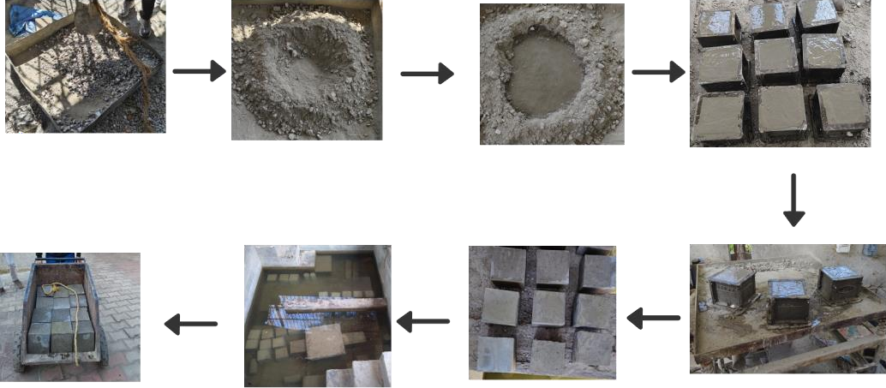
Casting of Concrete Cubes
Flow Diagram of the process of preparation of Concrete Cubes:

Slide 27
Procedure:
Mix Coarse and fine aggregate with cement according to the design mix calculations, then add water.
We have done manual mixing of the material.
Pour Concrete mix into the Moulds (oily) of dimension 150mmx150mmx150mm.
Place these Moulds on vibratory machine for 15 minutes.
Keep them still for 24 hours in mild moist environment.
Now take them off from the Moulds. And cure them for 7, 14, 28 Days submerged in the water.
After the required number of days, a Compression test is performed on each cube in 7, 14 and 28 days in a set of 3 cubes for same composition, respectively

Slide 28
Design Mix of M25 grade of concrete made with 100% recycled concrete aggregate
MATERIAL | DENSITY (Kg/m^3) | WEIGHT (Kg)
CEMENT | 412 | 12.5145
WATER | 186 | 5.64975
FINE AGGREGATE | 581 | 17.65
COARSE AGGREGATE (RCA) | 1097 | 33.321
WATER CEMENT RATIO | 0.49 | -

Slide 29
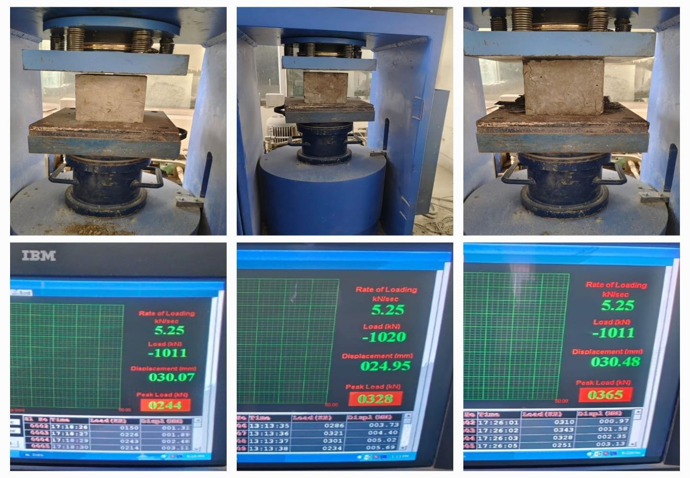

Slide 30
Compression Test result of concrete cubes made with 100% recycled concrete aggregate
DAYS | (1) | (2) | (3) | AVERAGE
7 days | 213 KN | 237 KN | 158 KN | 202 KN
14 days | 295 KN | 328 KN | 219 KN | 280 KN
28 days | 328 KN | 365 KN | 244 KN | 312.3 KN
Average compressive strength for 28 days =312.3KN
=13.86 N/mm^2

Slide 31
Design Mix of M25 grade of concrete made with 30% recycled concrete aggregate
MATERIAL | WEIGHT (Kg)
CEMENT | 12.5145
WATER | 5.649
FINE AGGREGATE | 17.65
RECYCLED COARSE AGGREGATE | 3.3321
NATURAL COARSE AGGREGATE | 8.313
WATER CEMENT RATIO | 0.49

Slide 32
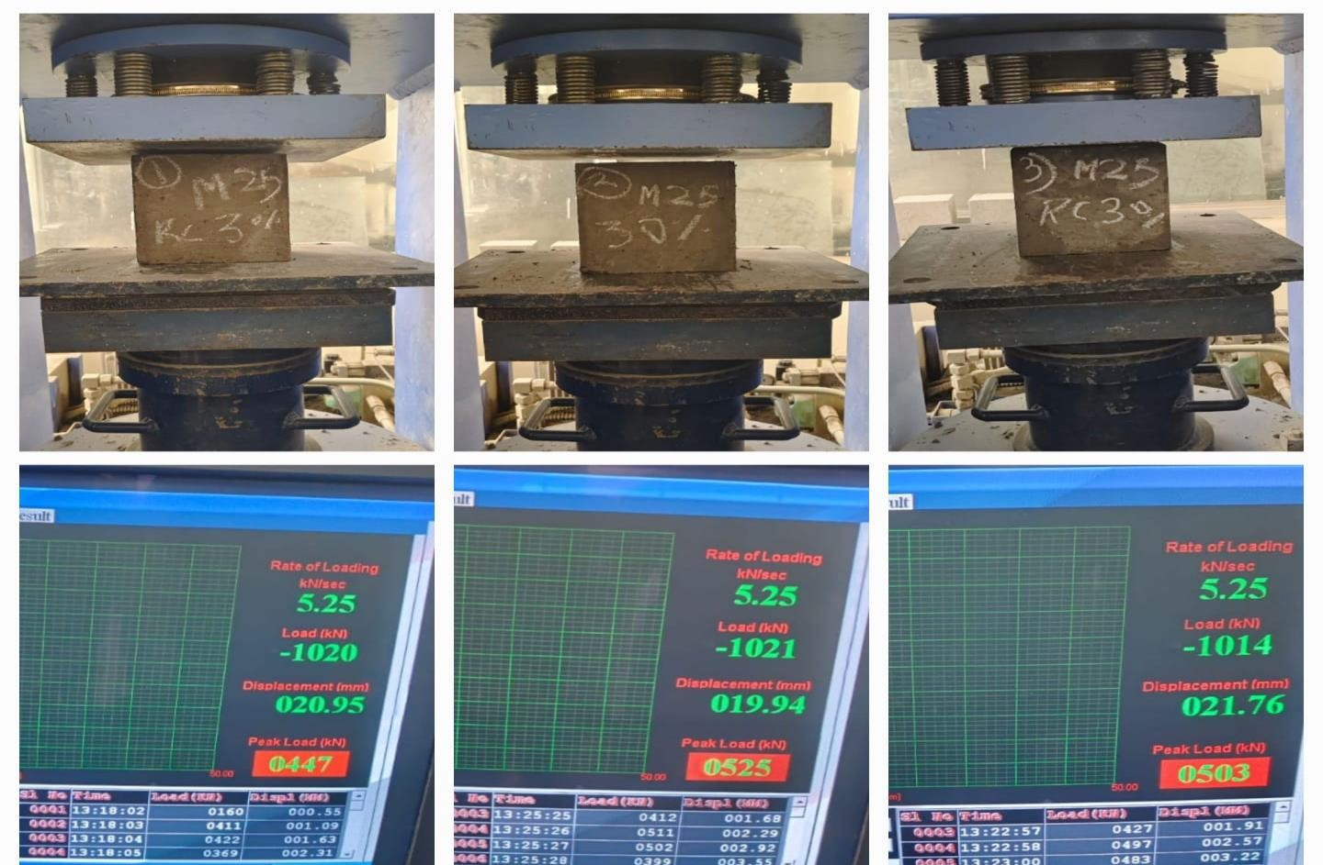

Slide 33
Compression Test result of concrete cubes made with 30% recycled concrete aggregate
DAYS | (1) | (2) | (3) | AVERAGE
7 days | 341 KN | 290 KN | 326 KN | 319 KN
14 days | 472 KN | 402 KN | 452 KN | 442 KN
28 days | 525 KN | 447 KN | 503 KN | 491 KN
Average compressive strength for 28 days =491KN
=21.85 N/mm^2

Slide 34
Design Mix of M25 grade of concrete made with 15% recycled concrete aggregate
MATERIAL | WEIGHT (Kg)
CEMENT | 12.5145
WATER | 5.649
FINE AGGREGATE | 17.65
RECYLED COARSE AGGREGATE | 1.66
NATURAL COARSE AGGREGATE | 10.095
WATER CEMENT RATIO | 0.49

Slide 35
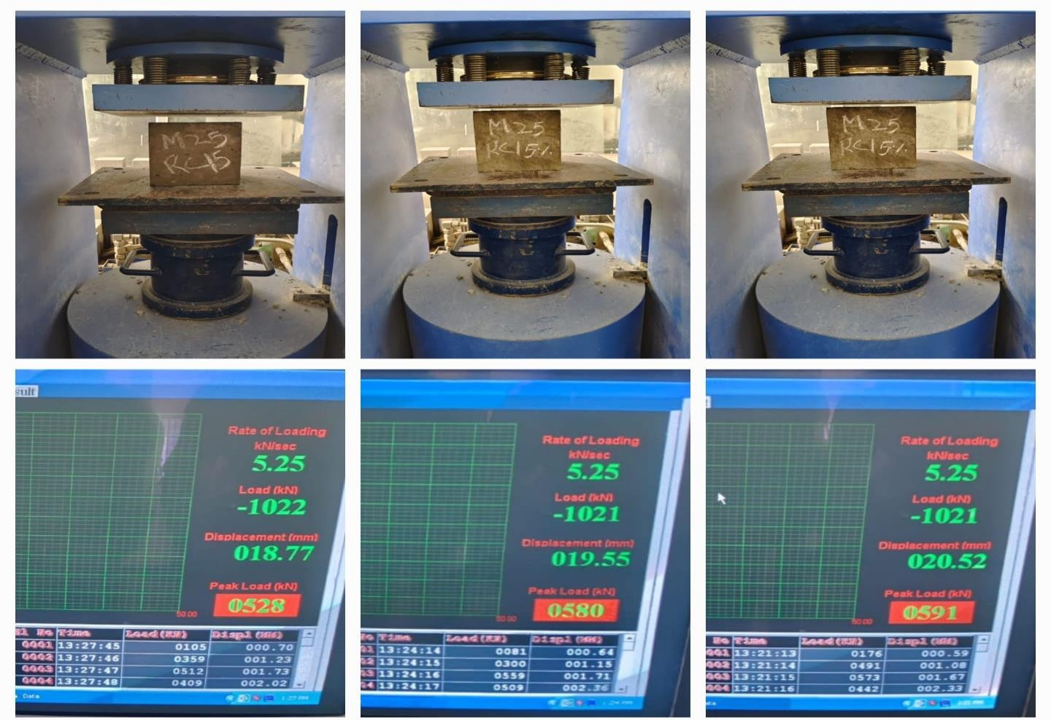

Slide 36
Compression Test result of concrete cubes made with 15% recycled concrete aggregate
DAYS | (1) | (2) | (3) | AVERAGE
7 days | 384 KN | 377 KN | 343 KN | 368 KN
14 days | 531 KN | 522 KN | 475 KN | 509 KN
28 days | 591 KN | 580 KN | 528 KN | 566 KN
Average compressive strength for 28 days =566KN
=25.16 N/mm^2

Slide 37
Design Mix of M25 grade of concrete made with 100% natural coarse aggregate
MATERIAL | DENSITY (Kg/m^3) | WEIGHT (Kg)
CEMENT | 412 | 12.5145
WATER | 186 | 5.64975
FINE AGGREGATE | 581 | 17.65
COARSE AGGREGATE (natural) | 1173 | 35.62
WATER CEMENT RATIO | 0.49 | -

Slide 38
Compression Test result of concrete cubes made with 100% natural coarse aggregate
DAYS | (1) | (2) | (3) | AVERAGE
7 days | 454 KN | 448 KN | 503 KN | 468 KN
14 days | 628 KN | 620 KN | 697 KN | 648 KN
28 days | 699 KN | 690 KN | 775 KN | 721 KN
Average compressive strength for 28 days =721KN
=32.04 N/mm^2

Slide 39
Comparison of average Compressive Strength of M25 grade of Concrete Cubes with different compositions of RCA and NCA for 7, 14 and 28 days :
DAYS | RCA(100%) | RCA(30%)+NCA(70%) | RCA(15%)+NCA(85%) | NCA(100%)
7 | 202KN | 319KN | 368KN | 468KN
14 | 280KN | 442KN | 509KN | 648KN
28 | 312KN =13.86 N/mm^2 | 491KN =21.85 N/mm^2 | 566KN =25.16 N/mm^2 | 721KN =32.06 N/mm^2

Slide 40
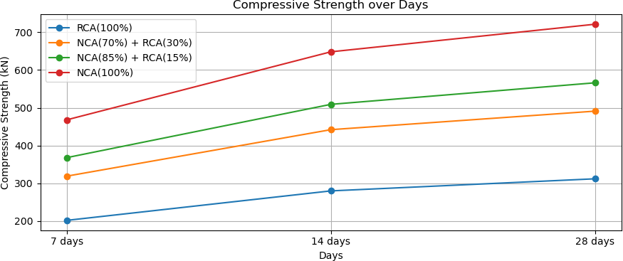

Slide 41
Conclusion:
This study has investigated the compressive strength of concrete mixtures incorporating varying proportions of Recycled Concrete Aggregate (RCA) in substitution for Natural Concrete Aggregate (NCA). The experimental results over a 28-day curing period demonstrate that a mixture comprising 15% RCA and 85% NCA achieves a compressive strength of 25.16 MPa, which satisfactorily aligns with the standard requirements for M25 grade concrete. In contrast, a mixture with a higher percentage of RCA, specifically 30% RCA and 70% NCA, yields a slightly lower compressive strength of 21.85 MPa, marginally below the M25 threshold.

Slide 42
References
IS 10262:2019, “Concrete mix proportions guidelines”
IS 383-2016, “Specifications for coarse and fine aggregates”.
IS 2386(III)-1963 (R2021), “Methods of test for aggregates of concrete Part 3 Specific gravity, density, voids, absorption and bulking”.
IS 456-2000 (R2021), “Plain and reinforced concrete- Code of practice (Fourth Revision)”.
A. W. Otunyo & B.G. Jephter, “Predictive model for compressive strength of concrete made from recycled concrete coarse aggregates” Dept. Of Civil Engineering, River State University, Nkpolu Port Harcourt, River State, Nigeria.

Slide 43
.….Thankyou…..

